Slide 1




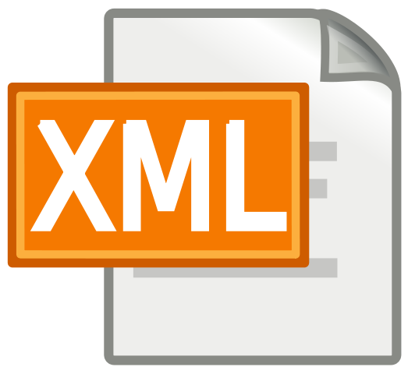

External Format Processing
Parsing JSON
JSON.NET, Parsing XML
JSON
XML
SoftUni Team
Technical Trainers
Software University
http://softuni.bg

Slide 2

Table of Contents
JSON Data Format
Processing JSON
JSON.NET
XML Format
Processing XML
XML in Entity Framework

Slide 3
Questions
sli.do #CSharpDB

Slide 4

The JSON Data Format
Definition and Syntax

Slide 5
JSON Data Format
JSON (JavaScript Object Notation) is a lightweight data format
Human and machine-readable plain text
Based on JavaScript objects
Independent of development platforms and languages
JSON data consists of:
Values (strings, numbers, etc.)
Key-value pairs: { key : value }
Arrays: [value1, value2, …}

Slide 6
JSON Data Format (2)
The JSON data format follows the rules of object creation in JS
Strings, numbers and Booleans are valid JSON:
Arrays are valid JSON:
Objects are valid JSON (key-value pairs):
"this is a string and is valid JSON"
3.14
true
[5, "text", true]
{
"firstName": "Vladimir", "lastName": "Georgiev",
"jobTitle": "Technical Trainer", "age": 25
}

Slide 7

Processing JSON
Parsing JSON in C# and .NET

Slide 8
Built-in JSON Support
.NET has a built-in DataContractJsonSerializer class
Contained in System.Runtime.Serialization assembly
Supports deserializing (parsing) strings and serializing objects
Including DataContractJsonSerializer into a project:
using System.Runtime.Serialization.Json;

Slide 9
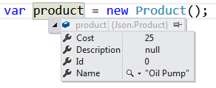
Serializing JSON
DataContractJsonSerializer can serialize an object:
static string SerializeJson<T>(T obj)
{
var serializer = new DataContractJsonSerializer(obj.GetType());
using (var stream = new MemoryStream())
{
serializer.WriteObject(stream, obj);
var result = Encoding.UTF8.GetString(stream.ToArray());
return result;
}
}
{
"Id":0,
"Name":"Oil Pump",
"Description":null,
"Cost":25
}

Slide 10
Deserializing JSON
DataContractJsonSerializer can deserialize a JSON string:
static T DeserializeJson<T>(string jsonString)
{
var serializer = new DataContractJsonSerializer(typeof(T));
var jsonStringBytes = Encoding.UTF8.GetBytes(jsonString);
using (var stream = new MemoryStream(jsonStringBytes))
{
var result = (T)serializer.ReadObject(stream);
return result;
}
}
{
"Id":0,
"Name":"Oil Pump",
"Description":null,
"Cost":25
}

Slide 11
JSON.NET
Newtonsoft
Json.NET
Better JSON Parsing for .NET Developers

Slide 12

What is JSON.NET?
JSON.NET is a JSON framework for .NET
More functionality than built-in functionality
Supports LINQ-to-JSON
Out-of-the-box support for parsing between JSON and XML
Open-source project: http://www.newtonsoft.com

Slide 13
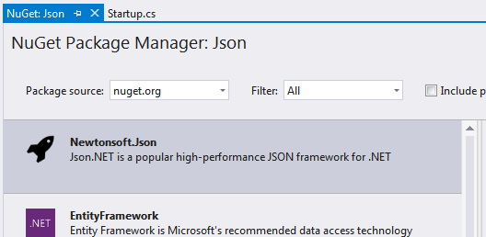
Installing JSON.NET
To install JSON.NET use the NuGet Package Manager:
Or with a command in the Package Manager Console:
Install-Package Newtonsoft.Json

Slide 14
General Usage
JSON.NET exposes a static service JsonConvert
Used for parsing and configuration
To Serialize an object:
To Deserialize an object:
var jsonProduct = JsonConvert.SerializeObject(product);
var objProduct =
JsonConvert.DeserializeObject<Product>(jsonProduct);

Slide 15
JSON.NET Features
JSON.NET can be configured to:
Indent the output JSON string
To convert JSON to anonymous types
To control the casing and properties to parse
To skip errors
JSON.NET also supports:
LINQ-to-JSON
Direct parsing between XML and JSON

Slide 16
Configuring JSON.NET
By default, the result is a single line of text
To indent the output string use Formatting.Indented
JsonConvert.SerializeObject(products, Formatting.Indented);
{
"pump": {
"Id": 0,
"Name": "Oil Pump",
"Description": null,
"Cost": 25.0
},
"filter": {
"Id": 0,
"Name": "Oil Filter",
"Description": null,
"Cost": 15.0
}
}

Slide 17
Configuring JSON.NET
Deserializing to anonymous types:
Incoming JSON
var json = @"{ 'firstName': 'Vladimir',
'lastName': 'Georgiev', 'jobTitle': 'Technical Trainer' }";
var template = new
{
FirstName = string.Empty,
LastName = string.Empty,
Occupation = string.Empty
};
var person = JsonConvert.DeserializeAnonymousType(json, template);
Template objects

Slide 18
JSON.NET Parsing of Objects
By default JSON.NET takes each property / field from the class and parses it
This can be controlled using attributes:
public class User
{
[JsonProperty("user")]
public string Username { get; set; }
[JsonIgnore]
public string Password { get; set; }
}
Parse Username to user
Skip the property

Slide 19
LINQ-to-JSON
LINQ-to-JSON works with JObjects
Create from JSON string:
Reading from file:
Using JObject:
JObject obj = JObject.Parse(jsonProduct);
var people = JObject.Parse(File.ReadAllText(@"c:\people.json"))
foreach (JToken person in people)
{
Console.WriteLine(person["FirstName"]); // Ivan
Console.WriteLine(person["LastName"]); // Petrov
}

Slide 20
LINQ-to-JSON (2)
JObjects can be queried with LINQ
var json = JObject.Parse(@"{'products': [
{'name': 'Fruits', 'products': ['apple', 'banana']},
{'name': 'Vegetables', 'products': ['cucumber']}]}");
var products = json["products"].Select(t =>
string.Format("{0} ({1})",
t["name"],
string.Join(", ", c["products"])
))
// Fruits (apple, banana)
// Vegetables (cucumber)

Slide 21
What is XML?
Format Description and Application

Slide 22

What is XML?
EXtensible Markup Language
Universal notation (data format / language) for describing structured data using text with tags
Designed to store and transport data
The data is stored together with the meta-data about it

Slide 23
XML – Example
XML header tag (prolog)
Attribute (key / value pair)
<?xml version="1.0"?>
<library name="Developer's Library">
<book>
<title>Professional C# 4.0 and .NET 4</title>
<author>Christian Nagel</author>
<isbn>978-0-470-50225-9</isbn>
</book>
<book>
<title>Teach Yourself XML in 10 Minutes</title>
<author>Andrew H. Watt</author>
<isbn>978-0-672-32471-0</isbn>
</book>
</library>
Root (document) element
Element
Opening tag
Closing tag
Element value

Slide 24
XML Syntax
Header – defines version and character encoding
Elements – define the structure
Attributes – element metadata
Values – actual data, can also be nested elements
Root element – required to only have one
<?xml version="1.0" encoding="UTF-8"?>
Element name
Attribute
Value
<title lang="en">Professional C# 4.0 and .NET 4</title>

Slide 25
XML - Structure
Header
Document
Document root
Attribute
Xml
version: 1.0
Library
name: Developer's Library
Book
Book
Book
Book
Child elements
Title
Author
ISBN
Professional C# 4.0 and .NET 4
Christian Nagel
978-0-470-50225-9
Value

Slide 26


XML and HTML
Similarities between XML and HTML
Both are text based notations
Both use tags and attributes
Differences between XML and HTML
HTML describes documents, XML is a syntax for describing other languages (meta-language)
HTML describes the layout of information, XML describes the structure of information
XML requires the documents to be well-formatted

Slide 27

XML: Advantages
Advantages of XML:
XML is human-readable (unlike binary formats)
Store any kind of structured data
Data comes with self-describing meta-data
Full Unicode support
Custom XML-based languages can be designed for certain apps
Parsers available for virtually all languages and platforms

Slide 28
XML: Disadvantages
Disadvantages of XML:
XML data is bigger (takes more space) than binary or JSON
More memory consumption, more network traffic, more hard-disk space, more resources, etc.
Decreased performance
CPU consumption: need of parsing / constructing the XML tags
XML is not suitable for all kinds of data
E.g. binary data: graphics, images, videos, etc.

Slide 29
Parsing XML
Using XDocument and LINQ

Slide 30
LINQ to XML
LINQ to XML
Use the power of LINQ to process XML data
Easily read, search, write, modify XML documents
LINQ to XML classes:
XDocument – represents a LINQ-enabled XML document (containing prolog, root element, …)
XElement – main component holding information

Slide 31
Reading XML
To process an XML string:
Loading XML directly from file:
string str =
@"<?xml version=""1.0""?>
<!-- comment at the root level -->
<Root>
<Child>Content</Child>
</Root>";
XDocument doc = XDocument.Parse(str);
XDocument xmlDoc = XDocument.Load("../../books.xml");

Slide 32
Working with XDocument
Access root element
Get collection of children
Access element by name
var cars = xmlDoc.Root.Elements();
foreach (var car in cars)
{
string make = car.Element("make").Value;
string model = car.Element("model").Value;
Console.WriteLine($"{make} {model}");
}
Get value

Slide 33
Working with XDocument (2)
Set element value by name
If it doesn't exist, it will be added
If set to null, will be removed
Remove element from it's parent
customer.SetElementValue("birth-date", "1990-10-04T00:00:00");
var youngDriver = customer.Element("is-young-driver");
youngDriver.Remove();

Slide 34
Working with XDocument (3)
Get or set element attribute by name
Get a list of all attributes for an element
Set attribute value by name
If it doesn't exist, it will be added
If set to null, will be removed
customer.Attribute("name").Value
var attrs = customer.Attributes;
customer.SetAttributeValue("age", "21");

Slide 35
LINQ to XML – Searching with LINQ
Searching in XML with LINQ is like searching with LINQ in array
XDocument xmlDoc = XDocument.Load("cars.xml");
var cars = xmlDoc.Root.Elements()
.Where(e => e.Element("make").Value == "Opel" &&
(long)e.Element("travelled-distance") >= 300000)
.Select(c => new
{
Model = c.Element("model").Value,
Traveled = c.Element("travelled-distance").Value
})
.ToList();
foreach (var car in cars)
Console.WriteLine(car.Model + " " + car.Traveled);

Slide 36
Creating XML with XElement
XDocuments can be composed from XElements and XAttributes
<books>
<book>
<author>Don Box</author>
<title lang="en">Essential .NET</title>
</book>
</book>
Added with value
XDocument xmlDoc = new XDocument();
xmlDoc.Add(
new XElement("books",
new XElement("book",
new XElement("author", "Don Box"),
new XElement("title", "ASP.NET", new XAttribute("lang", "en"))
)));
Add as root
Optional attribute

Slide 37
Serializing XML to File
To flush object to file with default settings:
To disable automatic indentation:
To serialize object to file:
xmlDoc.Save("myBooks.xml");
xmlDoc.Save("myBooks.xml", SaveOptions.DisableFormatting);
var serializer = new XmlSerializer(typeof(ProductDTO));
var writer = new StreamWriter("myProduct.xml");
using (writer)
{
serializer.Serialize(writer, product);
}

Slide 38

Summary
JSON and XML are cross platform data formats
DataContractJsonSerializer is the default JSON Parser in C#
JSON.NET is a fast framework for working with JSON data
XDocument is a system object for working with XML in .NET, which supports LINQ
XML can be read and saved directly to file

Slide 39







External Format Processing
https://softuni.bg/courses/databases-advanced-entity-framework

Slide 40
License
This course (slides, examples, demos, videos, homework, etc.) is licensed under the "Creative Commons Attribution-NonCommercial-ShareAlike 4.0 International" license
Attribution: this work may contain portions from
"Databases" course by Telerik Academy under CC-BY-NC-SA license

Slide 41





Trainings @ Software University (SoftUni)
Software University – High-Quality Education, Profession and Job for Software Developers
softuni.bg
Software University Foundation
http://softuni.foundation/
Software University @ Facebook
facebook.com/SoftwareUniversity
Software University Forums
forum.softuni.bg

